Slide 1
Hypertension Canada’s
Pharmacy Curriculum for the Prevention, Diagnosis, Assessment, and Treatment of Hypertension
Created by Dr. Arden Barry BSc, BSc(Pharm), PharmD, ACPR
Assistant Professor (Partner)
Faculty of Pharmaceutical Sciences, The University of British Columbia

Slide 2

Acknowledgement
Thank you to Lynette Kosar and Alex Crawley at RxFiles for their support and peer review

Slide 3
Acronyms
ABPM Ambulatory BP measurement
ACS Acute coronary syndrome
AOBP Automated office BP
ARNI Angiotensin receptor-neprilysin inhibitor
ARR Absolute risk reduction
BP Blood pressure
BMI Body mass index
CAD Coronary artery disease
CBT Cognitive behavioural therapy
CHD Coronary heart disease
CKD Chronic kidney disease
CV Cardiovascular
CVD Cardiovascular disease
DBP Diastolic blood pressure
DHP Dihydropyridine
DM Diabetes mellitus
ECG Electrocardiogram
eGFR Estimated glomerular filtration rate
HBPM Home BP measurement
HF Heart failure
HFrEF HF with reduced ejection fraction
HTN Hypertension
LVH Left ventricular hypertrophy
MAP Mean arterial pressure
MI Myocardial infarction
NNH Number needed to harm
NNT Number needed to treat
NSS Not statistically significant
OBPM Office BP measurement
PAD Peripheral artery disease
RCT Randomized controlled trial
SBP Systolic blood pressure
TIA Transient ischemic attack

Slide 4
Objectives
Identify risk factors for HTN.
Identify sequelae associated with HTN.
Develop an approach to measuring BP and assessing patients with HTN.
Review and summarize the evidence for non-pharmacologic and pharmacologic therapy in the treatment of HTN.
Use case examples to formulate a patient-specific care plan.

Slide 5
Resources
www.hypertension.ca

Slide 6
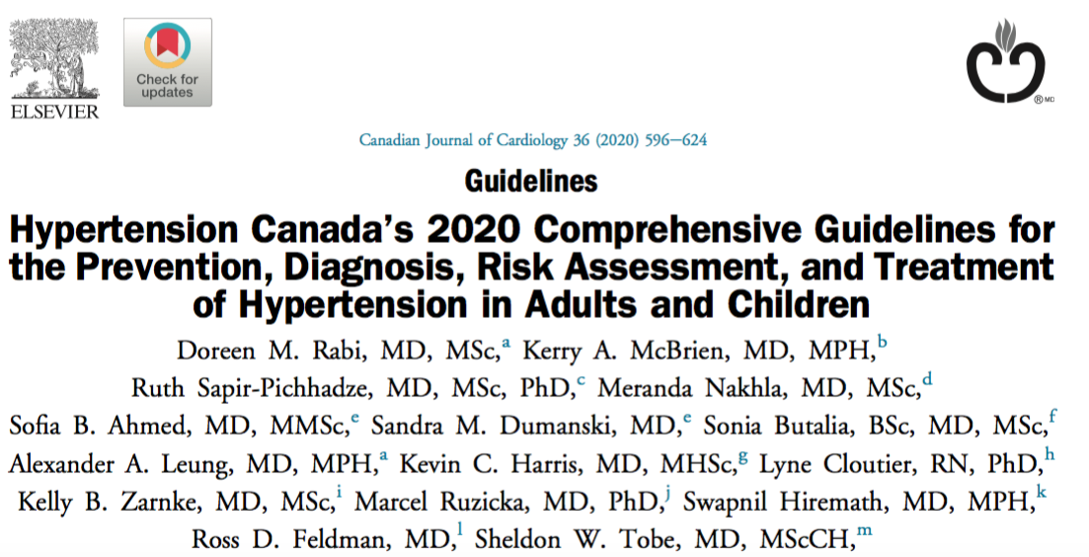
Guidelines
Can J Cardiol 2020;36:596-62
Notes:
CHEP has been producing guidelines since 1999

Slide 7
Practical Guide

Slide 8
Introduction

Slide 9


Prevalence of HTN in Canada
23% of Canadian adults have HTN
Most prevalent risk factor for CVD in Canada
More prescriptions for HTN than for any other medical disorder
  4 million prescriptions every month in Canada
Cost of HTN approaches 10% of all health care spending in Canada
  In 2010, HTN cost the Canadian health care system over $13 billion annually
Can J Cardiol 2020;36:596-624

Slide 10
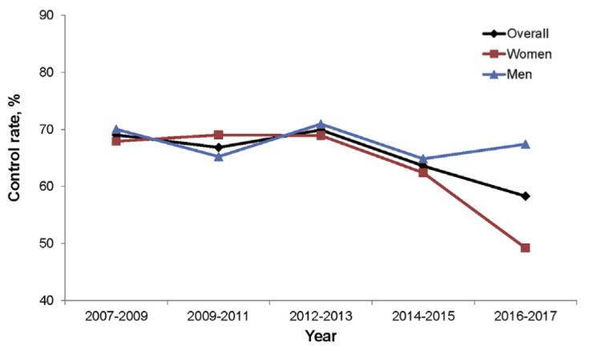
BP Control in Canada
Overall: 69% (2007) → 58% (2017)
67%
58%
49%
Can J Cardiol 2020;36:732-9

Slide 11
Global Prevalence of HTN
Leading global risk factor for death/disability
1.28 billion adults aged 30-79 yr have HTN
  ⅔ live in low- or middle-income countries
Estimated 46% of adults with HTN are unaware that they have condition
Estimated 21% of adults with HTN have BP controlled
www.who.int/health-topics/hypertension

Slide 12
Sequelae of HTN
Cerebrovascular disease/dementia
Retinopathy
CAD/MI
HF
Atrial fibrillation
LVH
CKD
PAD
Erectile dysfunction

Slide 13
Common Risk Factors for HTN
Age
Obesity
Poor dietary habits/high sodium intake
Sedentary behaviour
High alcohol intake
Smoking
DM
CKD
Can J Cardiol 2020;36:596-624

Slide 14
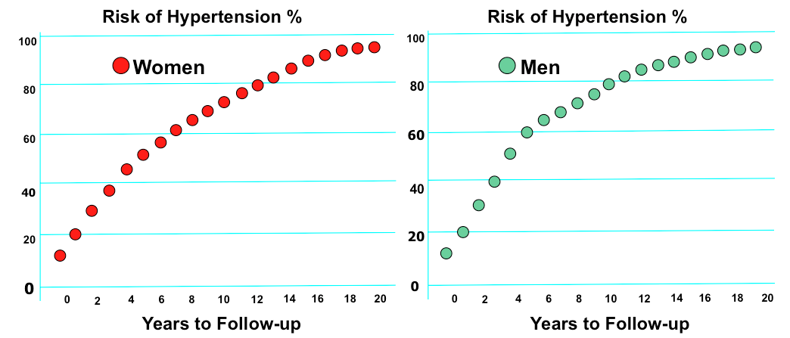
Lifetime Risk of HTN
Normotensive women and men aged 65 yr
JAMA 2002;287:1003-10

Slide 15
Secondary Causes of HTN
Endocrine disorders
  Pheochromocytoma
  Cushing’s syndrome
  Hyperthyroidism
Primary hyperaldosteronism
CKD
Obstructive sleep apnea
Drugs
Can J Cardiol 2016;32:569-88
Notes:
Who to screen for hyperaldosteronism:
Spontaneous hypokalemia (<3.5 mmol/L)
Profound diuretic-induced hypokalemia (<3.0 mmol/L)
HTN refractory to treatment with ≥3 antihypertensive drugs at maximum tolerated doses
Incidental adrenal adenomas
Who to screen for pheochromocytoma:
Paroxysmal, unexplained, labile, and/or severe (BP ≥180/110 mmHg) HTN refractory to usual antihypertensive therapy
Patients with HTN and symptoms suggestive of catecholamine excess (e.g., headaches, palpitations, sweating, panic attacks, pallor)
Incidental adrenal adenomas

Slide 16
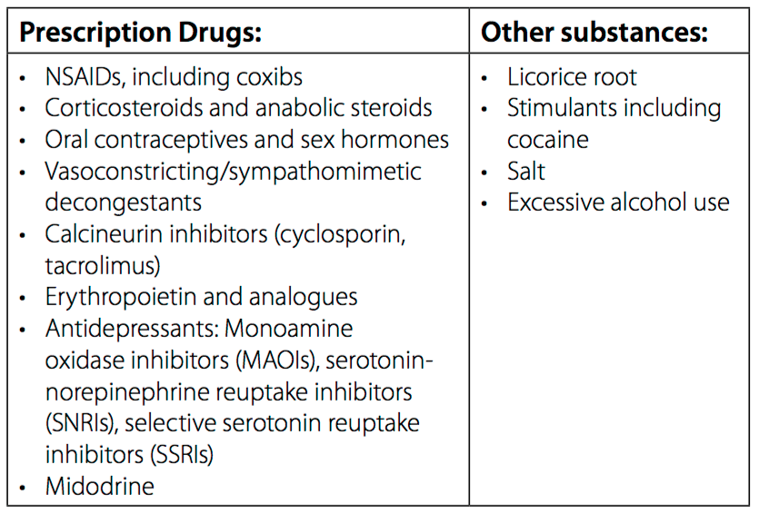
Secondary Causes of HTN
Can J Cardiol 2016;32:569-88

Slide 17
Who To Screen
“Frequency and timing of screening can be tailored to each patient’s risk of hypertension. Risk factors for hypertension are: (1) diabetes mellitus; (2) chronic kidney disease; (3) low level of consumption of fresh fruits and vegetables; and (4) sedentary behaviour.”
Can J Cardiol 2020;36:596-624

Slide 18
Measurement and Diagnosis

Slide 19
Measurement
“Health care professionals who have been specifically trained to measure BP accurately should assess BP in all adult patients at all appropriate visits to determine cardiovascular risk and monitor antihypertensive treatment.”
Can J Cardiol 2020;36:596-624

Slide 20
Measurement
Use standardized technique and validated equipment
Three approaches:
  Office BP measurement (OBPM) or automated office BP measurement (AOBP)
  Ambulatory BP measurement (ABPM)
  Home BP measurement (HBPM)
Can J Cardiol 2020;36:596-624

Slide 21
Office BP Measurement
AOBP
Automated device
Series of oscillometric measurements
Patient is left unattended in a private area with 3-6 consecutive readings
OBPM
Provider in the room
Oscillometric or electronic devices are preferred
Auscultatory (mercury or aneroid) if electronic is not available
Can J Cardiol 2020;36:596-624

Slide 22
Office BP Measurement
Electronic (oscillometric) upper arm devices are preferred over auscultation
Auscultatory BP is often inaccurate (9/6 mmHg higher)
  Too rapid deflation of cuff
  Digit preference (i.e. rounding to 0 or 5)
  Aneroid devices are less likely to remain calibrated
Can J Cardiol 2015;31:549-68; Can Fam Physician 2014;60:127-32;
Can J Cardiol 2020;36:596-624

Slide 23
Out-of-Office BP Measurement
ABPM or HBPM
Recommended for all adults with:
  High in-office BP (to rule out white coat HTN)
  Suspected HTN, particularly in adults with DM (to rule out masked HTN)
  Fluctuating in-office BP
  DM
  CKD
  Suspected non-adherence
Can J Cardiol 2020;36:596-624

Slide 24
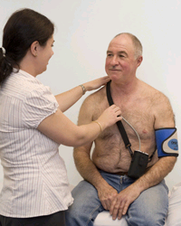
Ambulatory BP Measurement
Measurements taken at 20- to 30-min intervals over 24-hr period
Useful for diagnosing HTN
May not be covered in some provinces
Can J Cardiol 2020;36:596-624; www.hypertension.ca

Slide 25
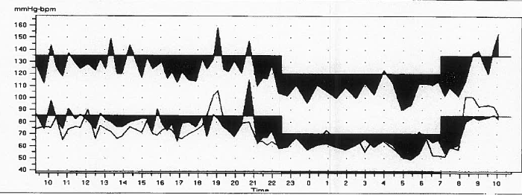
Ambulatory BP Measurement
Sleep
Awake
Each point represents a BP reading
BP
Time

Slide 26
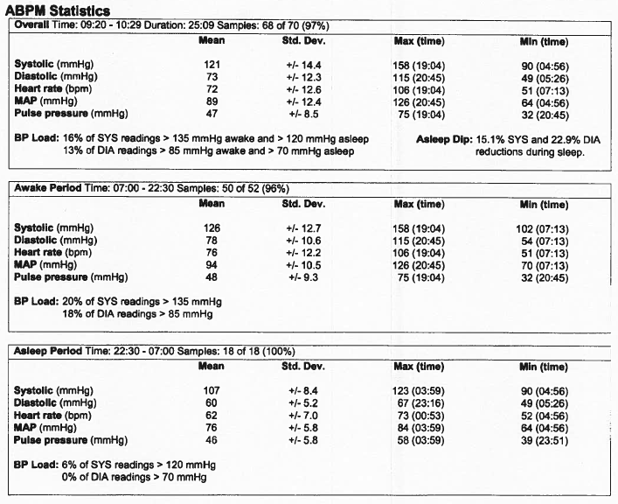
Ambulatory BP Measurement

Slide 27
Home BP Measurement
Requires patient to measure their BP twice daily (morning and evening) for 7 days
Useful for diagnosing HTN (using a device recommended by Hypertension Canada)
Can J Cardiol 2020;36:596-624
Notes:
Risk of masked HTN higher in patients with DM or CKD

Slide 28
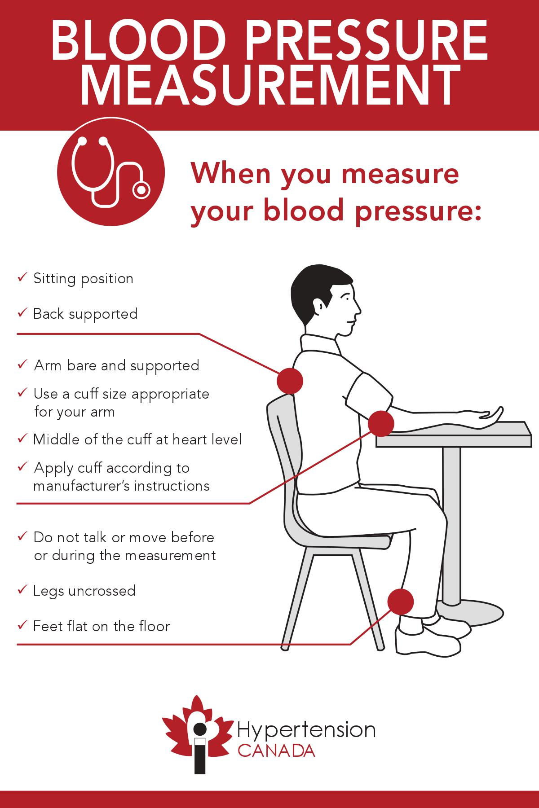


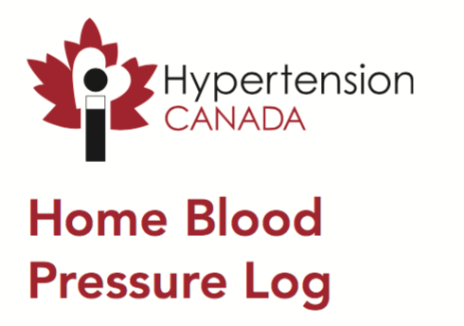
Home BP Measurement
Resources
www.hypertension.ca

Slide 29
Baseline Investigations
All patients with new HTN should undergo:
  CV risk assessment
  Non-fasting lipid panel
  Urinalysis
  Serum electrolytes and serum creatinine
  Fasting blood glucose or hemoglobin A1c
  Standard 12-lead ECG
Consider pregnancy in women of child-bearing potential with new HTN
Can J Cardiol 2020;36:596-624

Slide 30
Diagnosis of HTN
Mean OBPM ≥180/≥110 mmHg → HTN
“High” BP is defined as:
Assessment | Mean BP (mmHg)
AOBP | ≥135/≥85
OBPM | ≥140/≥90
24-hr ABPM | ≥130/≥80
Awake ABPM | ≥135/≥85
HBPM | ≥135/≥85
Can J Cardiol 2020;36:596-624
Notes:
Ambulatory or home BP measurement have better predictive ability than office BP measurement
Home BP measurement recommended if ambulatory BP measurement not tolerated, not readily available or due to patient preference
Identifies white coat HTN or masked HTN

Slide 31
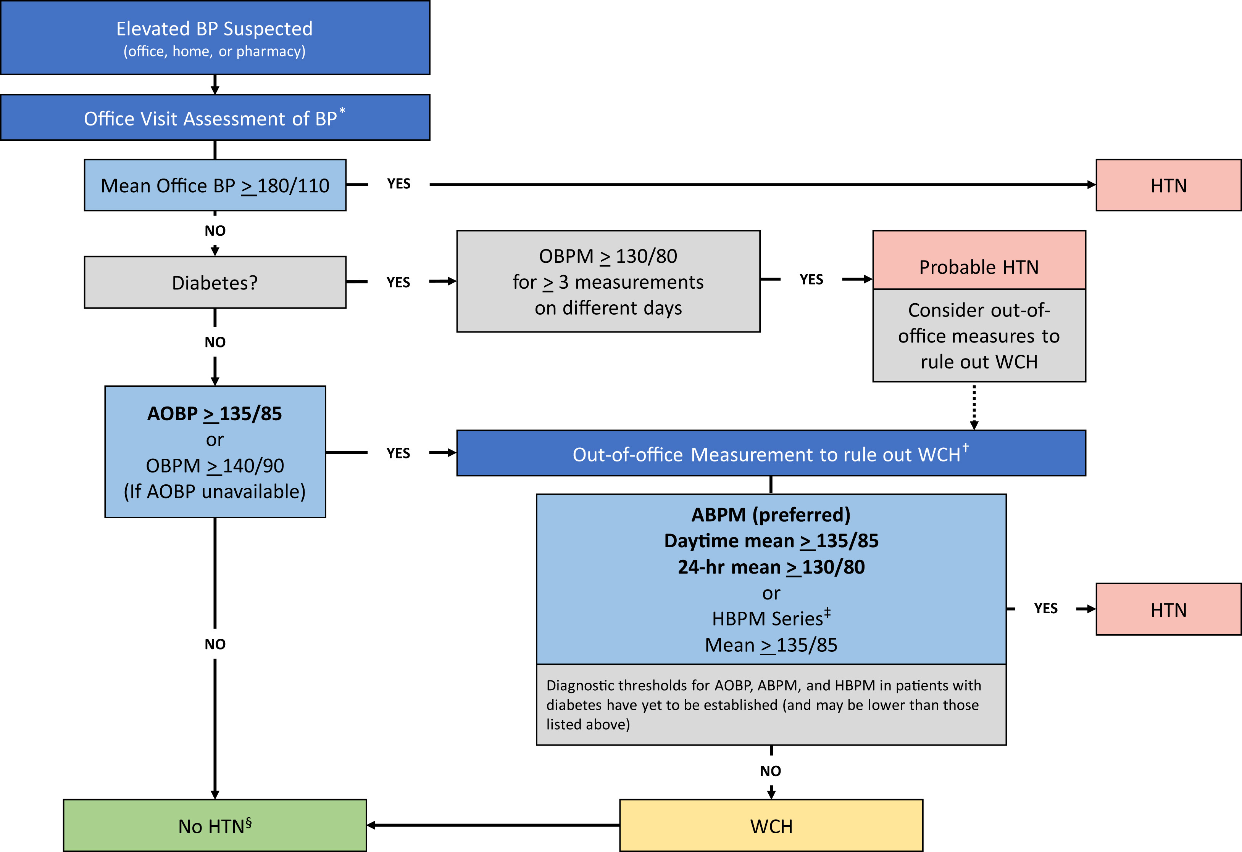
Can J Cardiol 2020;36:596-624

Slide 32
Case Example
BP at pharmacy = 142/83 mmHg
Mean AOBP = 134/79 mmHg
Do they have HTN?
6 mon later: mean AOBP = 148/94 mmHg
Mean awake ABPM = 133/84 mmHg
Mean 24-hr ABPM = 126/78 mmHg
Do they have HTN?
6 mon later: mean HBPM = 138/86 mmHg
Do they have HTN?
Notes:
No, as AOBP <135 and <85
No, as ABPM mean awake BP <135/85 and mean 24-hr SBP <130/80
Yes, as home BP >135/85

Slide 33
White Coat/Masked HTN
200
180
MASKED
HYPERTENSION
TRUE
HYPERTENSION
160
Ambulatory BP mmHg
140
135
120
WHITE COAT
HYPERTENSION
NORMOTENSION
100
100
120
140
160
180
200
Office BP mmHg
Hypertension 2002;40:795-6

Slide 34
White Coat HTN
Criteria | BP (mmHg)
Office BP | ≥140/90
Daytime ABPM | <135/85
24-hr ABPM | <130/80
Prevalence: up to 30% of patients with elevated BP
Clinical significance uncertain
May increase CV risk and mortality vs normotension
Pharmacologic treatment not recommended
Can J Cardiol 2015;31:549-68; Can J Cardiol 2016;32:569-88;
Ann Intern Med 2019;170:853-62

Slide 35
Masked HTN
Criteria | BP (mmHg)
Office BP | <140/90
Daytime ABPM | ≥135/85
24-hr ABPM | ≥130/80
Prevalence: 10-30% of the general population
Risk factors: males, high-normal clinic BP with LVH, DM, CKD, obesity, smokers, multiple CV risk factors
Can J Cardiol 2016;32:569-88; Ann Transl Med 2017;5:456
Notes:
Masked hypertension is ~10% of general population
The prevalence of masked HTN is higher in patients with diabetes (up to 43%) and kidney disease (up to 32%)
National and international registries suggest that when looking for masked HTN within office-controlled patients, up to one in three could have masked HTN

Slide 36
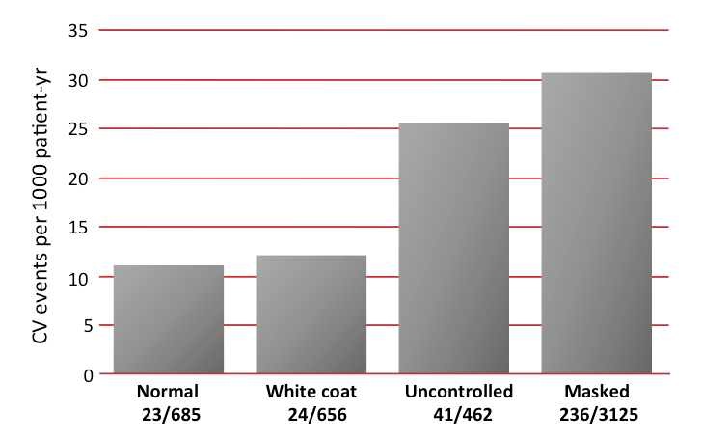
White Coat/Masked HTN
J Am Coll Cardiol 2005;46:508-15
Notes:
This study evaluated 24-hour ABPM and in-office BP values obtained from 1332 Japanese subjects who were followed for a mean of 10.2 years. The risk of CV events (CV mortality and stroke morbidity) in subjects with masked hypertension or uncontrolled hypertension was significantly higher than for subjects with normal BP or white coat hypertension. This pattern was observed across subgroups including men vs. women, treated vs. untreated hypertension, and high- vs. low-CV risk groups. This study provides evidence that white coat hypertension is associated with a more benign outcome than sustained hypertension over a period of 10 years, and in fact approximates outcomes of subjects with normotension. It also supports the observation that masked hypertension is a strong predictor of CV risk.

Slide 37
Monitoring
No HTN or target organ damage | BP every yr
Patients with HTN who are modifying health behaviours | BP every 3-6 mon BP every 1-2 mon for patients with higher BP
Patients with HTN on antihypertensive therapy | BP every 1-2 mon until BP below target for 2 consecutive visits BP every 3-6 mon once target BP is achieved
Can J Cardiol 2020;36:596-624

Slide 38
Key Points
Measurement using automated (oscillometric) upper arm devices is preferred for in-office BP measurement.
Use standardized technique for BP measurement.
Elevated in-office BP should be confirmed with out-of-office BP measurement, such as ABPM (preferred) or HBPM.
Can J Cardiol 2020;36:596-624

Slide 39
Treatment

Slide 40
Goals of Therapy
Prevent mortality
Prevent morbidity
  Target organ damage
Achieve BP target
  Goal is not to “normalize” BP
Prevent/minimize adverse effects

Slide 41
BP Treatment
Patients <60 yr of age (⬇ BP 10/5-6 mmHg)
  ⬇ relative risk of stroke by 42%
  ⬇ relative risk of coronary event by 14%
Patients >60 yr of age (⬇ BP 15/6 mmHg)
  ⬇ relative risk of CV mortality by 36%
  ⬇ relative risk of stroke by 35%
  ⬇ relative risk of coronary event by 18%
  ⬇ relative risk of all-cause mortality by 15%
Lancet 1990;335:827-38; Arch Fam Med 1995;4:943-50
Notes:
Mean BP in >60 yr study was 179/90 → 164/84 mmHg

Slide 42
BP Treatment
Epidemiologic impact of BP reduction on mortality in the population
Reduction in SBP (mmHg) | % Reduction
 | Stroke Mortality | CHD Mortality | Total Mortality
2 | -6 | -4 | -3
3 | -8 | -5 | -4
5 | -14 | -9 | -7
JAMA 2002;288:1882-8
Notes:
This slide is used to indicate the effect of ‘small’ changes in population BP associated with changes in population changes in lifestyle on the death rates from CVD

Slide 43
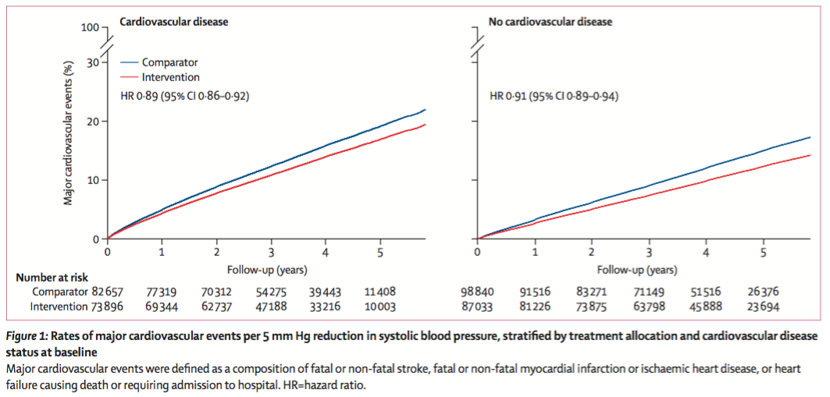
BP Treatment
Meta-analysis of 48 RCTs (N=344,716)
Follow-up: 4.2 yr
Lancet 2021;397:1625-36
Notes:
Blood Pressure Lowering Treatment Trialists’ Collaboration funded by British Heart Foundation, UK NIH and Oxford
“In this large-scale analysis of randomised trials, a 5 mmHg reduction of SBP reduced the risk of major CV events by about 10%, irrespective of previous diagnoses of CVD, and even at normal or high-normal blood pressure values.”

Slide 44
Health Behaviour

Slide 45
Health Behaviour
Intervention | Target
Decrease dietary sodium | <2000 mg/day
Physical activity | 30-60 min 4-7 days/week
Limit alcohol intake | 0-2 drinks/day
Dietary patterns | DASH diet, increase dietary potassium
Stress management | CBT and relaxation techniques
Smoking cessation | Smoke-free environment
Healthy weight | BMI 18.5-24.9 kg/m²
Waist circumference | Men <102 cm and women <88 cm
Can J Cardiol 2020;36:596-624
Notes:
Sodium: <5 g of salt or <87 mmol of sodium
Exercise: 30-60 minutes of moderate-intensity dynamic exercise (e.g. walking, jogging, cycling, or swimming) 4-7 days per week. Higher intensities of exercise are not effective. Use of resistance or weight training exercise (such as free-weight lifting, fixed-weight lifting or handgrip exercise) does not adversely influence BP.
Diet: fresh fruits, vegetables, low fat dairy, dietary and soluble fibre, whole grains and protein from plant sources, low in saturated fat, low cholesterol and salt
A standard drink is about 142 mL or 5 oz of wine (12% alcohol); 341 mL or 12 oz of beer (5% alcohol); 43 mL or 1.5 oz of spirits (40% alcohol)
Waist circumference should be measured just above the iliac crest
Do not recommend increased dietary K in patients on drugs that increase K: (ACEI, SMX-TMP), CKD (eGFR <45) or baseline serum K >4.5
Foods high in potassium: fresh fruits, vegetables and legumes

Slide 46
Health Behaviour
Intervention | SBP (mmHg) | DBP (mmHg)
Diet and weight control | -6.0 | -4.8
Reduced sodium intake | -5.4 | -2.8
Reduced alcohol intake (if heavy) | -3.4 | -3.4
DASH diet | -11.4 | -5.5
Physical activity | -3.1 | -1.8
Relaxation techniques | -5.5 | -3.5
Increased potassium intake | -3.5 | -2.0
NIH and NICE May 2011
Notes:
The extent of BP change from each intervention should not be compared because the participants, the type and duration of intervention, and the basic design of the trials differed substantially

Slide 47
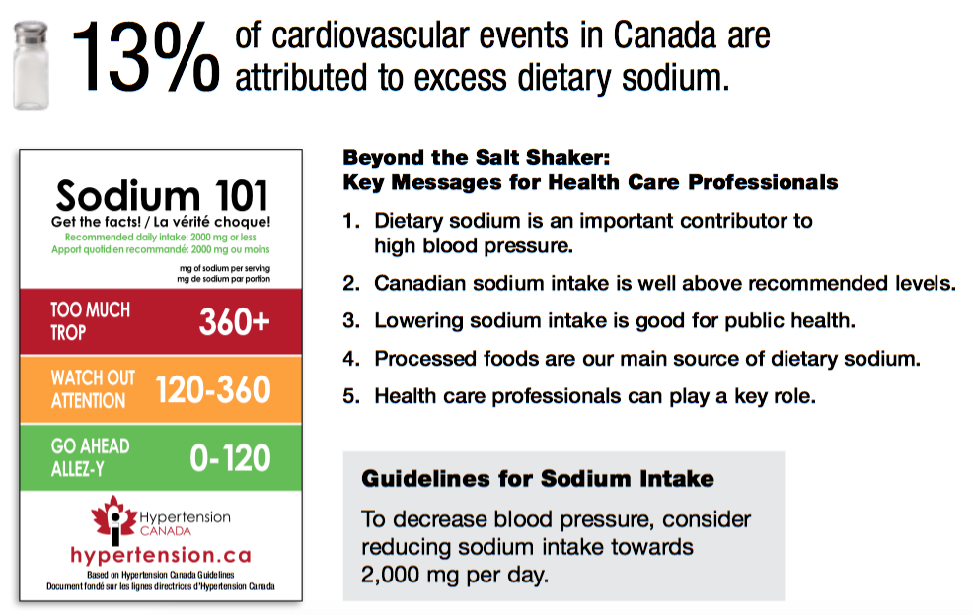
Sodium
Notes:
High dietary Na intake is estimated to increase BP to the extent that 1,000,000 Canadians meet the diagnostic criteria for HTN who would otherwise have “normal” BP
80% of average sodium intake is in processed foods and restaurants (pizza, bread, soups, sauces)
Only 10% is added at the table or in cooking
2,000 mg sodium (Na) = 87 mmol sodium (Na) = 5 g of salt (NaCl) ≈ 1 teaspoon of table salt

Slide 48
Sodium
If average dietary sodium reduced from 3500 mg → 1700 mg in Canada:
  1 million fewer patients with HTN
  5 million fewer physician visits/yr for HTN
  13% reduction in CV events
  Over $1.3 billion/yr in total health care cost savings
Can J Cardiol 2007:23:437-43; Can J Cardiol 2008;24:497-501

Slide 49
Potassium
Before recommending increased dietary potassium intake, assess patients for risk of hyperkalemia:
  Renin-angiotensin-aldosterone inhibitors
  Other drugs that can cause hyperkalemia (e.g. trimethoprim/sulfamethoxazole, amiloride, triamterene)
  CKD (eGFR <45 mL/min/1.73 m²)
  Baseline serum potassium >4.5 mmol/L
Can J Cardiol 2020;36:596-624

Slide 50
DASH Diet
Dietary Approaches to Stop Hypertension:
  Fruit/vegetables/legumes
  Grains/nuts/seeds
  Low fat/non-fat dairy
  Lean meat/poultry/fish
N Engl J Med 2001;344:3-10
Notes:
Similar pattern with DBP: difference 2.9 mmHg for high, 2.5 mmHg for intermediate, 1 mmHg for low

Slide 51
Key Points
Health behaviour change is strongly recommended as a first-line intervention to lower BP in people with HTN.
Excess dietary sodium intake is a significant contributor to HTN.

Slide 52
Pharmacotherapy

Slide 53
Pharmacotherapy
Angiotensin-converting enzyme inhibitors (ACEIs)
Angiotensin receptor blockers (ARBs)
β-blockers
Calcium channel blockers (CCBs)
Diuretics
Miscellaneous:
  Mineralocorticoid receptor antagonists (MRAs)
  Vasodilators
  α1-blockers
  Centrally-acting agents (α2-agonists)
  Direct renin inhibitors

Slide 54
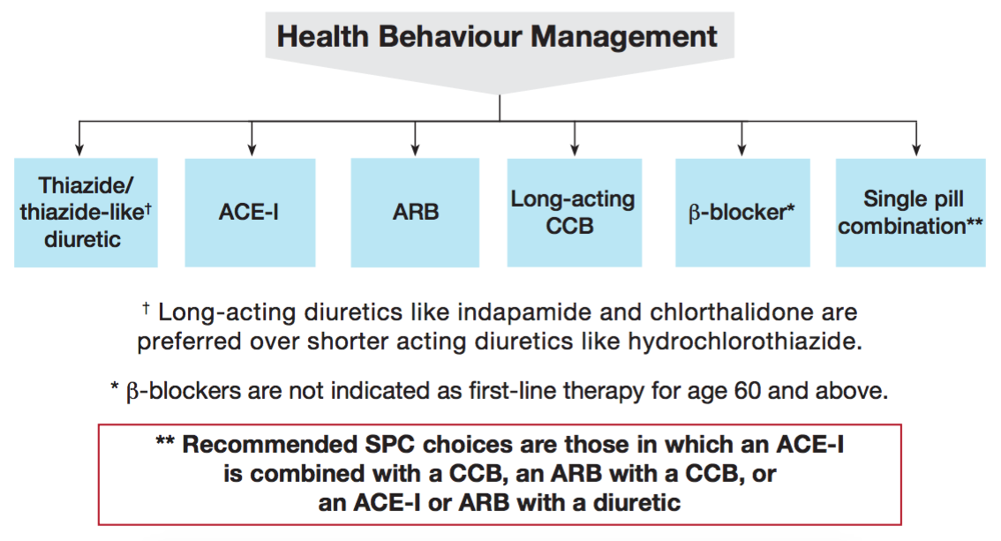
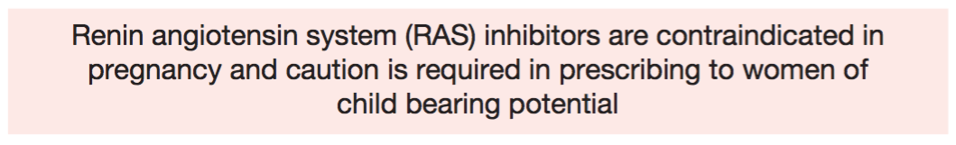
Pharmacotherapy
Can J Cardiol 2020;36:596-624
Notes:
Use shared decision-making, use BP thresholds and targets, use SPC whenever possible
CDSR compared ACEIs vs ARBs; 9 RCTs; N=11,007; no difference in all-cause mortality, CV mortality or CV events; lower withdrawals due to adverse effects with ARBs (mainly due to cough); technically, ARBs have never been compared to placebo in HTN trials
ACEI are not recommended as first-line for black patients

Slide 55
ACEIs
Generic name | Trade name | Usual adult dose
Benazepril | Lotensin® | 5-40 mg PO daily
Captopril | Capoten® | 6.25-50 mg PO tid
Cilazapril | Inhibace® | 2.5-10 mg PO daily
Enalapril | Vasotec® | 2.5-40 mg PO daily (or 20 mg PO bid)
Fosinopril | Monopril® | 10-40 mg PO daily
Lisinopril | Zestril®/Prinivil® | 5-40 mg PO daily
Perindopril | Coversyl® | 2-8 mg PO daily
Quinapril | Accupril® | 5-40 mg PO daily
Ramipril | Altace® | 2.5-20 mg daily (or 10 mg PO bid)
Trandolapril | Mavik® | 0.5-4 mg daily
Lexi-Comp; RxFiles 13th edition
Notes:
Ramipril dosed BID in heart failure

Slide 56
ARBs
Generic name | Trade name | Usual adult dose
Azilsartan | Edarbi® | 40-80 mg PO daily
Candesartan | Atacand® | 8-32 mg PO daily
Eprosartan | Teveten® | 400-800 mg PO daily
Irbesartan | Avapro® | 150-300 mg PO daily
Losartan | Cozaar® | 25-100 mg PO daily
Olmesartan | Benicar® | 20-40 mg PO daily
Telmisartan | Micardis® | 40-80 mg PO daily
Valsartan | Diovan® | 80-320 mg PO daily
Lexi-Comp; RxFiles 13th edition

Slide 57
ACEI/ARBs
Contraindications:
  Bilateral renal artery stenosis
  Hypersensitivity
  Pregnancy
  History of angioedema (ACEI)
Lexi-Comp

Slide 58
ACEI/ARBs
Adverse effects:
CNS | Lightheadedness/dizziness, headache
ENT | Angioedema (ACEI)
CVS | Hypotension/orthostatic hypotension
RESP | Dry cough (ACEI)
GI | Nausea/vomiting, dysgeusia
GU | Renal dysfunction
ENDO | Hyperkalemia
DERM | Rash
Lexi-Comp
Notes:
Monitor usual parameters: BP, K, SCr
Monitor Li levels and symptoms of toxicity
Dysgeusia = taste disturbance
Angioedema (0.5%) – increased risk with blacks
Cough (10-20%)

Slide 59
ACEI/ARBs
Drug interactions:
Potassium-sparing diuretics | Hyperkalemia
Potassium supplements | Hyperkalemia
Lithium | Increased lithium levels
NSAIDs | Renal dysfunction, increased BP
Cotrimoxazole | Hyperkalemia
ACEI and ARB should not be used in combination for HTN (due to risk of hyperkalemia and renal dysfunction)
Lexi-Comp

Slide 60
Case Example
Recently started on ramipril for HTN
Developed a cough while on vacation
Stopped his ACEI because he read on the internet that it causes cough
What is your approach? What would you recommend?
Notes:
Dry or productive? Other symptoms of URTI (e.g. congestion, headache, rhinorrhea)? Does cough occur persistently or intermittently?
Other reason for cough (e.g. HF, asthma, GERD)?
Did cough get better when he stopped it? Consider re-challenge?
ACEI-induced cough tends to be dry, continuous, and not associated with other symptoms

Slide 61
β-blockers
Generic name | Trade name | Usual adult dose | Cardioselective
Acebutolol | Sectral® | 100-400 mg PO daily | Yes
Atenolol | Tenormin® | 12.5-100 mg PO daily | Yes
Bisoprolol | Monocor® | 2.5-10 mg PO daily | Yes
Carvedilol | Coreg® | 6.25-25 mg PO bid | No
Labetalol | Trandate® | 100-400 mg PO bid | No
Metoprolol | Lopressor® | 12.5-100 mg PO bid | Yes
Nadolol | Corgard® | 40-80 mg PO daily | No
Pindolol | Visken® | 5-20 mg PO bid | No
Propranolol | Inderal® | 10-80 mg PO bid | No
Sotalol | Betapace® | 80-160 mg PO bid | No
Timolol | Blocadren® | 10-20 mg PO bid | No
Lexi-Comp; RxFiles 13th edition
Notes:
Excluded: esmolol and oxprenolol (discontinued)

Slide 62
β-blockers
  β-blockers are not recommended as first-line for patients aged ≥60 yr without another indication
  β-blockers are inferior vs other agents
  Diuretic therapy more effective than β-blockers at reducing CV events, CV death and all-cause death in patients ≥60 yr of age
  Higher risk of stroke vs other agents
  No reduction in death
JAMA 1998;279:1903-7; Lancet 2005;366:1545-53;
Cochrane Database Syst Rev 2012;11:CD002003

Slide 63
β-blockers
Combination β- and α1-blockers:
  Examples: carvedilol and labetalol
  More potent antihypertensive agents
Intrinsic sympathomimetic activity (ISA):
  Examples: acebutolol and pindolol
  Partial β-agonist activity
  Less negative effects on heart rate, glucose, lipids and respiratory system
  Avoid in stable angina and post-MI
Lexi-Comp; RxFiles 13th edition
Notes:
Oxprenolol now discontinued by manufacturer

Slide 64
β-blockers
Contraindications:
  Severe asthma (cardioselective β-blockers may be safe in mild-to-moderate asthma)
  2° or 3° heart block
  Decompensated HF
  Severe PAD
  Pheochromocytoma (without α1-blocker)
  Hypersensitivity
Lexi-Comp; RxFiles 13th edition
Notes:
Caution in COPD (use cardioselective)

Slide 65
β-blockers
Adverse effects:
CNS | Fatigue, lightheadedness/dizziness, insomnia, vivid dreams, decreased libido
CVS | Bradycardia, hypotension, decreased exercise tolerance, heart block
RESP | Bronchospasm
ENDO | Masking of hypoglycemia, increased blood glucose and triglycerides, lowered HDL-C
DERM | Cold extremities
Other | Impotence
Lexi-Comp; RxFiles 13th edition
Notes:
Lipophilicity causes more CNS adverse effects (propranolol)
May exacerbate HF, PAD or Raynaud’s disease
May mask or delay symptoms of hypoglycemia (exception: sweating)
Do not discontinue β blockers abruptly (taper over 2-4 weeks)

Slide 66
β-blockers
Drug interactions:
Amiodarone | Bradycardia
Non-DHP CCBs | Bradycardia, hypotension
Digoxin | Bradycardia
NSAIDs | Hypertension
Insulin | Inhibits hypoglycemic response
Lexi-Comp; RxFiles 13th edition
Notes:
Beta-blockers inhibit glycogenolysis, therapy inhibiting hypoglycemic response

Slide 67
CCBs
Generic name | Trade name | Usual adult dose | DHP
Amlodipine | Norvasc® | 2.5-10 mg PO daily | Yes
Diltiazem | Cardizem®/Tiazac® | 30-60 mg PO tid 120-360 mg ER PO daily | No
Felodipine | Renedil®/Plendil® | 2.5-10 mg ER PO daily | Yes
Nifedipine | Adalat® | 5-30 mg PO tid 30-120 mg XL PO daily | Yes
Verapamil | Isoptin® | 40-160 mg PO tid 120-240 mg ER PO daily | No
Lexi-Comp; RxFiles 13th edition
Notes:
Diltiazem ER and CD peak in 6-11 hr
Diltiazem XC peaks in 11-15 hr (dose at hs)
Diltiazem CD or ER ≠ XC

Slide 68
CCBs
 | Dromotropy | Chronotropy | Inotropy | Peripheral Vascular Resistance
Diltiazem | ⎢ | ⎢ | ⎢ | ⎢
Verapamil | ⎢⎢ | ⎢ | ⎢⎢ | ⎢⎢
Amlodipine | – | – | –/⎡ | ⎢⎢⎢
Felodipine | – | –/⎡ | –/⎡ | ⎢⎢⎢
Nifedipine | – | –/⎡ | –/⎢ | ⎢⎢⎢
RxFiles 13th edition
Notes:
Dromotropy = AV node conduction
Chronotropy = HR
Inotropy = contractility
Bathmotropy = excitability

Slide 69
CCBs
Contraindications:
  Severe hypotension (SBP <90 mmHg)
  HF after acute MI
  HFrEF (except amlodipine)
  2° or 3° heart block or sick sinus syndrome
  Hypersensitivity
Lexi-Comp; RxFiles 13th edition
Notes:
PRAISE trial (amlodipine) NEJM 1996

Slide 70
CCBs
Adverse effects:
CNS | Lightheadedness/dizziness, headache
CVS | Hypotension, bradycardia/heart block (non-DHP), reflex tachycardia (DHP), decreased exercise tolerance
GI | Constipation (verapamil)
DERM | Rash (diltiazem), flushing (DHP)
Other | Peripheral edema (DHP)
Lexi-Comp; RxFiles 13th edition

Slide 71
CCBs
Drug interactions:
β-blockers (non-DHP) | Bradycardia, hypotension
CYP3A4 inhibitors | Increased CCB level
CYP3A4 substrates | Increased CYP3A4 substrate level
CYP3A4 inducers | Decreased CCB level
Digoxin | Bradycardia, increased digoxin level
Amiodarone | Bradycardia
NSAIDs | Hypertension
Lexi-Comp; RxFiles 13th edition
Notes:
CYP3A4 inhibitors: grapefruit juice, azole antifungals, macrolide antibiotics, protease inhibitors
CYP3A4 substrates: ALS statins

Slide 72
Thiazide/Thiazide-Like Diuretics
Generic name | Trade name | Usual adult dose
Chlorthalidone | Hygroton® | 12.5-25 mg PO daily
Hydrochlorothiazide | Hydrodiuril® | 12.5-50 mg PO daily
Hydrochlorothiazide/amiloride | Moduret® | 50/5 mg PO daily
Hydrochlorothiazide/spironolactone | Aldactazide® | 25/25 mg PO daily
Hydrochlorothiazide/triamterene | Dyazide® | 25/50 mg PO daily
Indapamide | Lozide® | 1.25-2.5 mg PO daily
Lexi-Comp; RxFiles 13th edition
Notes:
Hydrochlorothiazide is a thiazide diuretic
Chlorthalidone and indapamide are thiazide-like diuretics

Slide 73
Thiazide/Thiazide-Like Diuretics
Long-acting thiazide-like diuretics (chlorthalidone, indapamide) are recommended over thiazide (hydrochlorothiazide) diuretics
  No head-to-head RCTs
  Meta-analysis of 21 RCTs demonstrated 12% ⬇ in CV events and 21% ⬇ in HF after adjusting for differences in BP reduction
  Chlorthalidone may have higher risk of hypokalemia and hyponatremia vs hydrochlorothiazide
Hypertension 2015;65:1033-40; Ann Intern Med 2013;158:447-55
Notes:
Ontario cohort study: chlorthalidone not associated with fewer adverse CV events or deaths, but greater incidence of hospitalization due to hypoK or hypoNa

Slide 74
Thiazide/Thiazide-Like Diuretics
Contraindications:
  Anuria
  Gout
  Hyponatremia
  Severe sulfa allergy
  Hypersensitivity
  Breastfeeding
Lexi-Comp; RxFiles 13th edition

Slide 75
Thiazide/Thiazide-Like Diuretics
Adverse effects:
CNS | Lightheadedness/dizziness
CVS | Hypotension/orthostatic hypotension
GI | Nausea/vomiting, diarrhea
GU | Renal dysfunction, interstitial nephritis
ENDO | Hypokalemia, hyponatremia, hypomagnesemia, hypercalcemia, hyperglycemia, hyperuricemia
DERM | Alopecia, rash, non-melanoma skin cancer, Stevens-Johnson syndrome
Lexi-Comp; RxFiles 13th edition

Slide 76
Thiazide/Thiazide-Like Diuretics
Drug interactions:
Digoxin | Increased digoxin level (hypokalemia and hypomagnesemia)
Lithium | Increased lithium level
NSAIDs | Renal dysfunction
Corticosteroids | Hypokalemia
Lexi-Comp; RxFiles 13th edition

Slide 77
Miscellaneous
Drug | Class | Usual adult dose
Spironolactone | MRA | 25-50 mg PO daily
Doxazosin | α1-blocker | 1-2 mg PO daily
Prazosin | α1-blocker | 0.5-4 mg PO bid
Terazosin | α1-blocker | 1-5 mg PO daily
Clonidine | α2-agonist | 0.1-0.2 mg PO bid
Methyldopa | α2-agonist | 250 mg PO bid
Hydralazine | Arteriodilator | 10-50 mg PO qid
Minoxidil | Arteriodilator | 10 mg PO bid
Aliskiren | Direct renin inhibitor | 150-300 mg PO daily
Lexi-Comp; RxFiles 13th edition

Slide 78
Combination Therapy
Multiple drugs are often required to reach BP target
Lower doses of multiple drugs may be more effective (and better tolerated) than higher doses of fewer drugs
Try to use single pill combinations whenever possible
Avoid ACEI + ARB (renal impairment and hypotension)
Caution re: β-blocker + non-DHP CCB (bradycardia)
Caution re: ACEI/ARB + potassium-sparing diuretic (hyperkalemia)
Can J Cardiol 2020;36:596-624

Slide 79
Complex Comorbidities
Condition | First-Line Therapy | Notes
Isolated systolic HTN | Thiazide/thiazide-like diuretic, ARB, or DHP CCB | ACEI not recommended as first-line
CAD | ACEI or ARB (β-blocker or CCB for stable angina) | ACEI and DHP CCB preferred Caution if DBP ≤60 mmHg Avoid short-acting nifedipine
Recent MI | ACEI and β-blocker (ARB if ACEI intolerant)
HFrEF | ACEI (ARB if ACEI intolerant) or ARNI, β-blocker, and MRA | Avoid non-DHP CCB Could use ACEI and ARB
LVH | ACEI, ARB, long-acting CCB, or thiazide/thiazide-like diuretic | Avoid hydralazine and minoxidil
Stroke/TIA | ACEI and thiazide/thiazide-like diuretic
Can J Cardiol 2020;36:596-624

Slide 80
HTN and DM/CKD
 | First-Line Therapy | Notes
DM with nephropathy* or CVD | ACEI or ARB | Addition of DHP CCB preferred over thiazide/thiazide-like diuretic
DM without nephropathy or CVD | ACEI, ARB, DHP CCB, or thiazide/thiazide-like diuretic
Non-DM CKD with proteinuria** | ACEI (ARB if ACEI intolerant)
* Nephropathy defined as microalbuminuria (urine albumin to creatinine ratio >2.0 mg/mmoL) or CKD (eGFR <60 mL/min)
** Proteinuria defined as urinary protein >500 mg/24 hr or urine albumin to creatinine ratio >30 mg/mmoL
Can J Cardiol 2020;36:596-624

Slide 81
BP Targets

Slide 82
BP Thresholds and Targets
Patient population | BP threshold (mmHg) for initiation of therapy | BP target (mmHg) for treatment
Low risk (no target organ damage or CV risk factors) | SBP ≥160 DBP ≥100 | SBP <140 DBP <90
High risk of CVD* | SBP ≥130 | SBP <120
DM | SBP ≥130 DBP ≥80 | SBP <130 DBP <80
All others | SBP ≥140 DBP ≥90 | SBP <140 DBP <90
* Established CVD or CKD or estimated 10-yr CV risk ≥15% or age ≥75 yr
Can J Cardiol 2020;36:596-624
Notes:
Recommend measurement by AOBP

Slide 83
SPRINT
N=9361
Included: patients aged ≥50 yr with HTN (SBP 130-180 mmHg) at high risk of CVD:
  Subclinical or clinical CVD
  CKD (eGFR 20-59 mL/min/1.73 m²)
  Estimated 10-year CV risk ≥15%
  Age ≥75 yr
Excluded patients with DM or stroke
N Engl J Med 2015;373:2103-16
Notes:
Open-label
Sponsored by NHLBI
CV risk: CVD, CKD, FRS ≥15%, age ≥75
Did not report how many patients had HF…?
Treatment: thiazide-type diuretic and/or ACEI and/or ARB (but not both), and/or CCB (BB for compelling indications)

Slide 84
SPRINT
  Baseline: Mean age 68 yr, 25% female, 20% CVD, 20% CKD
  Intervention: SBP <120 mmHg
  Comparator: SBP 135-139 mmHg
  Primary outcome: composite of CV death, ACS, HF and stroke
  Standardized treatment algorithm
  Follow-up: 3.3 yr (stopped early)

Slide 85
SPRINT
SBP: 122 mmHg vs 135 mmHg
Number of medications: 2.8 vs 1.8
N Engl J Med 2015;373:2103-16

Slide 86
SPRINT
Primary outcome: 5.2% vs 6.8% (ARR 1.6%, NNT=63)
N Engl J Med 2015;373:2103-16

Slide 87
SPRINT
SBP <120 mmHg:
  ⬇ risk of HF, CV death, and all-cause death
  No difference in MI or stroke
  ⬆ risk of hypotension, electrolyte abnormalities, and renal dysfunction
Subgroup of age ≥75 yr (28% of population):
  Mean age 80 yr, 38% female
  ⬇ primary outcome, all-cause death, and HF
  No difference in adverse events (?underpowered)
N Engl J Med 2015;373:2103-16; JAMA 2016;315:2673-82

Slide 88
STEP
N=8511
Patients in China aged 60-80 years with HTN (SBP 140-190 mmHg)
Excluded patients with stroke
SBP target 110-129 mmHg vs 130-149 mmHg
Primary outcome: composite of stroke, ACS, acute decompensated HF, coronary revascularization, AF and CV death
Standardized treatment algorithm
Follow-up: 3.3 yr
N Engl J Med; published online 2021 Aug 30
Notes:
Randomized, multicentre, open-label trial
Mean age 66 yr, 53% women, 19% had DM, 6% had CVD, 65% had FRS ≥15%

Slide 89
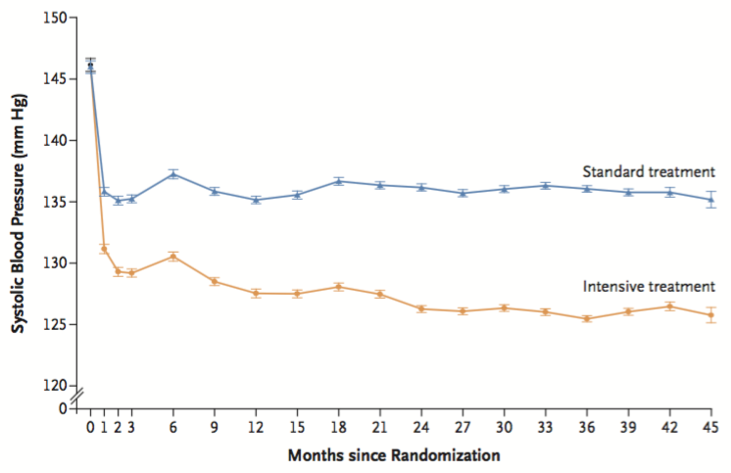
STEP
SBP: 127 mmHg vs 136 mmHg
Number of medications: 1.9 vs 1.5
N Engl J Med; published online 2021 Aug 30
Notes:
At 1 year of follow-up, mean SBP was 127.5 mmHg in the intensive-treatment group and 135 mmHg in the standard-treatment group. During the median follow-up period of 3.3 years, mean decrease in SBP from baseline was 19 mmHg in the intensive-treatment group and 10 mmHg in the standard-treatment group. Throughout follow-up, mean SBP was 127 mmHg in the intensive-treatment group and 136 mmHg in the standard-treatment group. At 42 months (3.5 yr), mean number of antihypertensive medications per patient was 1.9 in the intensive-treatment group and 1.5 in the standard-treatment group.

Slide 90
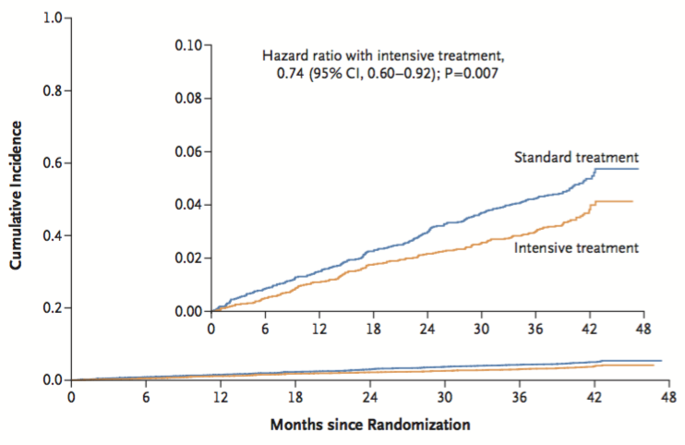
STEP
Primary outcome: 3.5% vs 4.6% (ARR 1.1%, NNT=91)
N Engl J Med; published online 2021 Aug 30
Notes:
Hypotension more common in intensive-treatment group: 3.4% vs 2.6%, ARI 0.8%, NNH 125
Syncope, dizziness, adverse renal outcomes NSS

Slide 91
Case Example
Taking ramipril 5 mg PO daily for HTN
HBPM: 137/85 mmHg
Mean OBPM: 142/88 mmHg
What is his BP target?
What would you recommend?
Notes:
Target SBP <120 based on SPRINT
Meets SPRINT criteria because he his FRS >15%
Recommend addition of another agent (e.g., CCB or thiazide-like combination such as perindopril/indapamide)

Slide 92
Case Example
Now taking perindopril/indapamide 4/1.25 mg PO daily for HTN and BP below target
Develops severe chest pain while on stage
Diagnosed with an MI
Does this change his BP target?
What would you recommend?
Notes:
Recommend addition of beta-blocker and discontinue indapamide

Slide 93
Resistant HTN

Slide 94
Resistant HTN
10-30% of patients with HTN
Definition: BP above target despite combination of ≥3 antihypertensives of different classes, one of which is a diuretic
Typical regimen = ACEI/ARB + DHP CCB + thiazide-like diuretic
Accurate in-office and out-of-office BP measurement is essential
Can J Cardiol 2020;36:596-624

Slide 95
Resistant HTN
Other reasons for apparent resistant HTN:
  Non-adherence
  White coat effect
  Obstructive sleep apnea
  Secondary HTN
    Drugs
    Primary hyperaldosteronism
    Pheochromocytoma
May warrant referral to specialist (HTN clinic)
Can J Cardiol 2020;36:596-624

Slide 96
Resistant HTN
Add-on therapeutic options:
  Spironolactone or eplerenone
  Bisoprolol
  Doxazosin
  Amiloride
  Clonidine

Slide 97
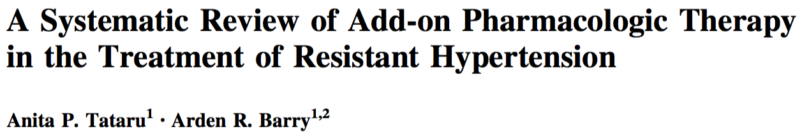
Resistant HTN
6 RCTs
Spironolactone vs placebo or active comparator
Reduced mean office BP by 10-20/3-9 mmHg and home BP by 10/4 mmHg
Rate of hyperkalemia with ACEI/ARB: about 3%
Am J Cardiovasc Drugs 2017;17:311-8
Notes:
“Based on these data, spironolactone appears to be the optimal pharmacotherapeutic agent in patients with RH receiving baseline therapy with three antihypertensive agents. These data are limited by several factors such as low enrollment, short follow-up, and inconsistent reporting outcomes; however, in the absence of large, head-to-head RCTs, these data support that an MRA should be the drug of choice in addition to standard therapy in patients with RH.”

Slide 98
PATHWAY-2
N=335
Patients with resistant HTN
Spironolactone vs doxazosin vs bisoprolol vs placebo x 12 weeks
Spironolactone superior to comparators at reducing office and home SBP
No difference in office or home DBP
Lancet 2015;386:2059-68
Notes:
DB crossover design
RH defined as an office systolic BP ≥140 mmHg (or ≥135 mmHg for patients with diabetes) and home systolic BP of ≥130 mmHg despite treatment for at least three months with maximally tolerated doses of three drugs (ACEI or ARB, CCB, and diuretic)
ABPM not reported

Slide 99
Resistant HTN
Prospective observational cohort study
N=48 adults with resistant HTN
Baseline ABPM: 154/91 mmHg
All patients had directly observed therapy
1-month follow-up:
  Mean change in SBP: -11 mmHg
  Resistant HTN resolved in 30% of patients (mean change in SBP -22 mmHg)
JAMA Intern Med 2019;179:1433-4
Notes:
Conducted in Ottawa
Median number of BP drugs at baseline: 4

Slide 100
Case Example
Now taking:
  Perindopril 4 mg PO daily
  Bisoprolol 5 mg PO daily
  ASA 81 mg PO daily
  Atorvastatin 80 mg PO daily
Mean OBPM: 135/78 mmHg
What would you recommend?
Notes:
Could maximize ACEI and BB or add DHP CCB (e.g., amlodipine)

Slide 101
Case Example
6 mon later:
  Perindopril 8 mg PO daily
  Bisoprolol 10 mg PO daily
  Amlodipine 10 mg PO daily
  ASA 81 mg PO daily
  Atorvastatin 80 mg PO daily
Mean OBPM: 123/77 mmHg
What would you recommend?
Notes:
Could consider adding thiazide-like diuretic
Depends on his values and preferences

Slide 102
Key Points
Choice of first-line pharmacotherapy is based on individual patient factors.
Treat to BP target.
Low doses of multiple drugs often more effective than high doses of fewer drugs.
Consider complex comorbidities.
Evaluate non-adherence and consider spironolactone for resistant HTN.

Slide 103
Key Clinical Trials

Slide 104
HOT
N=18,790
Age 50-80 yr with HTN (DBP 100-115 mmHg)
DBP ≤90 mmHg vs ≤85 mmHg vs ≤80 mmHg x 3.8 yr
Outcomes:
  Lowest risk of CV events: 139/83 mmHg
  Lowest risk of CV mortality: 139/87 mmHg
  DM: ⬇ CV events with DBP ≤80 vs ≤90 mmHg
Lancet 1998;351:1755-62
Notes:
Felodipine was baseline therapy followed by 5-step regimen (+/- ACEI, BB, diuretic)
BP achieved: 144/85 vs 141/83 vs 140/81

Slide 105
HOPE
N=9297
Age ≥55 with CVD or DM + ≥1 CV risk factor
Ramipril 10 mg PO daily vs placebo x 5 yr
Outcomes:
  Ramipril ⬇ 1° composite CV endpoint, CV death, MI, stroke, and all-cause death
N Engl J Med 2000;342:145-53
Notes:
Patients with HF were excluded
BP 136/76 mmHg and 139/77 mmHg, respectively, at the end of the study
Δ in BP with ramipril from baseline 3/3 mmHg

Slide 106
ALLHAT
N=42,418
Age ≥55 yr with HTN and ≥1 CV risk factor
Amlodipine vs lisinopril vs doxazosin vs chlorthalidone x 4.9 yr
Outcomes:
  CV events or all-cause death NSS
  Doxazosin arm d/c early due to ⬆ CVD and HF vs chlorthalidone
  Chlorthalidone had ⬇ rate of HF vs amlodipine and ⬇ rate of stroke and HF vs lisinopril
JAMA 2002;288:2981-97
Notes:
Chlorthalidone is a thiazide-like diuretic
Funded by NHLBI
Nearly one-half of participants were women; more than one-third were African American; and more than one-third had DM
Doxazosin arm was stopped early due to a 25% higher rate of combined CVD and 2-fold higher rate of HF compared to chlorthalidone

Slide 107
ONTARGET
N=25,620
CVD or DM and end-organ damage
Telmisartan vs ramipril vs both x 4.7 yr
Outcomes:
  Telmisartan non-inferior to ramipril for 1° CV composite endpoint
  CV composite endpoint NSS between combination and ramipril, but ⬆ hypotension, syncope, and renal dysfunction
N Engl J Med 2008;358:1547-59
Notes:
Mean age 66, DM 38%

Slide 108
HYVET
N=3845
Age ≥80 with HTN (SBP ≥160 mmHg)
Indapamide ± perindopril to achieve BP <150/80 mmHg vs placebo x 1.8 yr (d/c early)
Outcomes:
  Nonfatal/fatal stroke NSS
  ⬇ risk of all-cause death, death from stroke, HF, and any CV event with treatment
N Engl J Med 2008;358:1887-98
Notes:
Mean age 84, 60% female, 12% CVD, 7% stroke, BP 173/91
Achieved BP 144/78 vs 159/84 (reduction of 15/6)

Slide 109
ACCOMPLISH
N=11,506
Age >55 yr with HTN (SBP ≥160 mmHg) and high CV risk
Benazepril + hydrochlorothiazide vs benazepril + amlodipine x 3 yr (d/c early)
Outcomes:
  Composite of CV death and CV events ⬇ with benazepril/amlodipine
  CV death and all-cause death NSS
N Engl J Med 2008;359:2417-28
Notes:
Mean age 68, 60% DM
Lower BP in amlodipine arm (0.9/1.1 mmHg)

Slide 110
ACCORD-BP
N=4733
T2DM and age ≥40 yr with CVD or ≥55 yr with CV risk factors
SBP <120 mmHg vs <140 mmHg x 4.7 yr
Outcomes:
  CV events NSS
  ⬆ serious adverse events, hypotension, bradycardia, and hyperkalemia with SBP <120 mmHg target
N Engl J Med 2010;362:1575-85
Notes:
Open-label
Mean age 62, 48% female

Slide 111
Hypertensive Crisis

Slide 112
Hypertensive Crisis
SBP >180 mmHg and/or DBP >110 mmHg
Risk factors:
  Non-adherence
  Pregnancy
  Endocrine disorders
  Drugs (cocaine, methamphetamines)
Urgency
No end-organ damage
Emergency
End-organ damage
Emerg Med Clin N Am 2015;33:539-51
Notes:
Some references say SBP >220 and DBP >120

Slide 113
Hypertensive Crisis
Symptoms:
  Confusion
  Headache
  Epistaxis
  Dyspnea
  Chest pain
  ⬇ urine output
Emerg Med Clin N Am 2015;33:539-51
Notes:
Complications: stroke/seizures, papilledema, flash pulmonary edema, myocardial infarction, aortic dissection
Delirium/seizures caused by encephalopathy
Pulmonary edema secondary to volume overload

Slide 114
Hypertensive Crisis
Complications:
  Stroke
  Delirium/seizures
  Pulmonary edema
  Aortic dissection
  MI
  Acute renal failure
Emerg Med Clin N Am 2015;33:539-51

Slide 115
Hypertensive Crisis
Treatment:
  Avoid precipitous drop in BP
  Urgency:
    PO medication
    Reduce MAP by 25% in first 24-48 hr
  Emergency:
    IV medication (e.g. labetalol 20-80 mg IV q 10 min)
    Reduce MAP by 20-25% or DBP <110 mmHg in first 1-2 hr
Emerg Med Clin N Am 2015;33:539-51
Notes:
Mean arterial pressure (MAP) = 2 x DBP + SBP / 3
Rapid BP drop can cause cerebral, cardiac and renal ischemia

Slide 116
Hypertensive Disorders of Pregnancy

Slide 117
Hypertensive Disorders of Pregnancy
Up to 7% of pregnancies, but expected to increase
  Women becoming pregnant later in their reproductive years
  Prevalence of CV comorbidities
Sequelae:
  Pre-eclampsia
  Placental abruption
  Prematurity or small for gestational age infants
  Stillbirth
  Maternal renal or retinal injury
Can J Cardiol 2020;36:596-624
Notes:
Placental abruption: placenta separates from the wall of the uterus before birth

Slide 118
Pre-Eclampsia
Hypertensive disorder of pregnancy
HTN and proteinuria
  2-6% of pregnancies after 20th week of gestation
  Can lead to eclampsia (seizures → stroke, death)
Therapeutic alternatives:
  Labetalol
  Methyldopa
  Nifedipine XL
  Other β-blockers
ACEI/ARBs contraindicated (teratogenic)
Emerg Med Clin N Am 2015;33:539-51; Can J Cardiol 2020;36:596-624
Notes:
Cause unknown
Life-threatening to both mother and fetus
Definitive treatment of eclampsia is delivery of placenta
Magnesium also plays a role in treatment

Slide 119
Hypertensive Disorders of Pregnancy
Pregnancy |  |  | Lactation
First-line | Second-line | Avoid | First-line
Labetalol Methyldopa Nifedipine XL β-blockers (acebutolol, metoprolol, pindolol, propranolol) | Clonidine Hydralazine Thiazide diuretics | ACEI/ARBs | Labetalol Methyldopa Nifedipine XL Captopril Enalapril
Can J Cardiol 2020;36:596-624
Notes:
ACEI/ARB could be used pre-conception, but should be switched once pregnancy confirmed (low risk in first trimester)

Slide 120
Other Interventions

Slide 121
Adherence
Educational:
  Remind patient/family of indication and benefit
  Provide written and verbal information
Behavioural:
  Tailor regimen to patient’s daily habits
  Motivational interviewing
  Simplify regimen: long-acting once-daily medications or single pill combinations
  Adherence aid or reminder system
Pharmacy Practice+ 2015;2(5):9-16
Notes:
Challenge to educate patients regarding benefit in preventive therapy

Slide 122
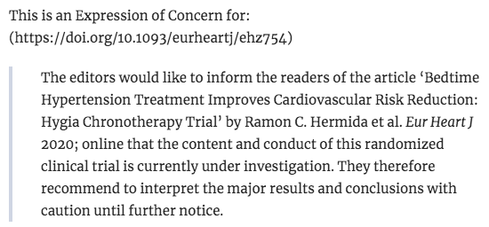
Nocturnal Dosing
  Take ≥1 antihypertensive agent at HS vs all in the AM
  MAPEC:
  N=2156
  Follow-up: 5.6 yr
  Difference in mean asleep BP: 5/2 mmHg
  CV events: 6.3% vs 17.3% (NNT=10)
Hygia Chronotherapy Trial:
  N=19,084
  Follow-up: 6.3 yr
  Difference in mean asleep BP: 3/2 mmHg
  CV events: aHR 0.55 (95% CI 0.50-0.61)
Chronobiol Int 2010;27:1629-51; Eur Heart J 2019;ehz754
Notes:
Rationale: peak RAAS occurs during sleep
Conducted in Spain and funded by unrestricted research grants, both trials were PROBE design
MAPEC: mean age 56, 52% female, 20% DM, CV event rates much higher than expected
Hygia: mean age 61, 44% female

Slide 123
Pharmacist Care
SCRIP-HTN:
  N=227
  Pharmacist/nurse care vs usual care x 6 mon
  ⬇ SBP by 6 mmHg compared to control
RxACTION:
  N=248
  Pharmacist care vs usual care x 6 mon
  ⬇ SBP by 7 mmHg compared to control
  2-fold increase in odds of achieving BP target
Arch Intern Med 2008;168:2355-61; Circulation 2015;132:93-100
Notes:
Conducted at community pharmacies
RxACTION including prescribing by pharmacists

Slide 124
Questions and Discussion

